Slide 1




Smart Shopping List
SHAYMA CHEHDI
HADHEMI WESLETI
2019-2020

Slide 2


Plan
Smart Shopping list Project
Architecture & technologies used
Implementation
& Test
1
3
5
2
4
6
Mind Engineering
Conception
Agility

Slide 3

Mind Engineering
What’s Mind Engineering
Mind Engineering was created 05/01/2016 in the form of an LLC.
Web agency specialized in the design of innovative software solutions
Mind Engineering offers innovative solutions with new communications technologies.
Web site hosting
Web desingning
Creaate non realisable operations inside the server
1
Notes:
Un cluster est un groupe de serveur indépendant fonctionnenet comme un seul et meme

Slide 4






Smart Shopping List
Recommandation system
Mobile application
Giving the user the ability to select and choose the products he needs all with
specifying the price for each list
Helping us to not lose any
information while or after
writing a list
Facilitate the creation of a personal
customizable list of our needs from the market.
Optimize shopping run in
distance and price
2

Slide 5
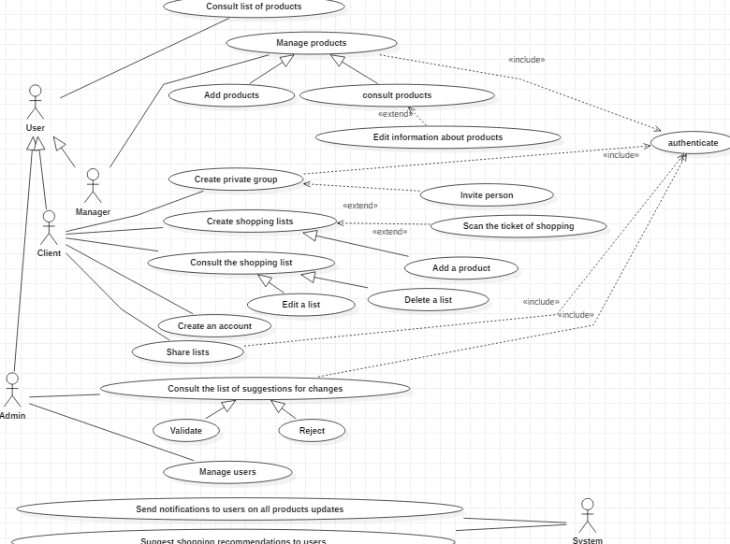
Conception
3

Slide 6
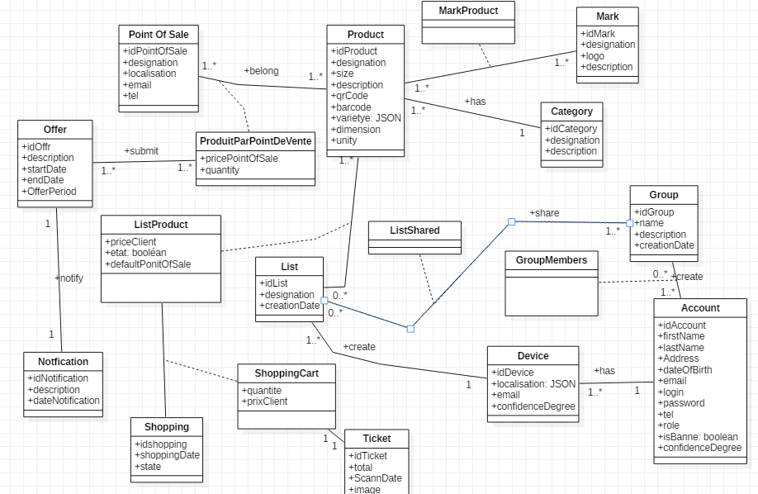
4

Slide 7
Technologies Used
+
Python 3,6 /Flask Framework
+
MongoDB
+
SQLAlchemy
+
Saas platform: Docker/Containers
+
Gitlab Mind Engineering
4

Slide 8
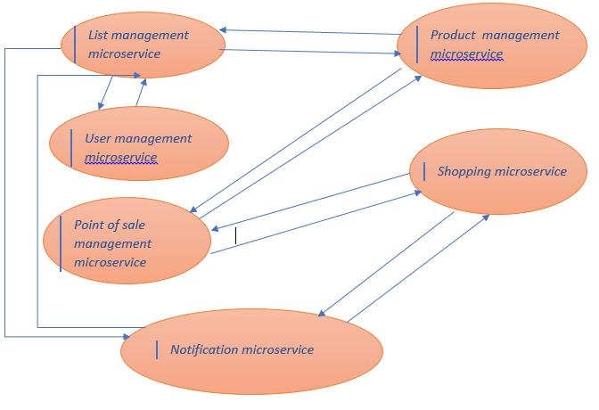
Microservice Architecture
Technological agility.
Extensibility.
Factoring and reuse of microservices.
Scalability.
A product, not a project: In the microservices vision, a team is responsible for a product throughout its life cycle. She is entirely responsible software in production.
5

Slide 9

Agility
As an agility method we are used the scrum methodology
Group of 5 students and a scrum master who was the manager of Mind Engineering
6

Slide 10
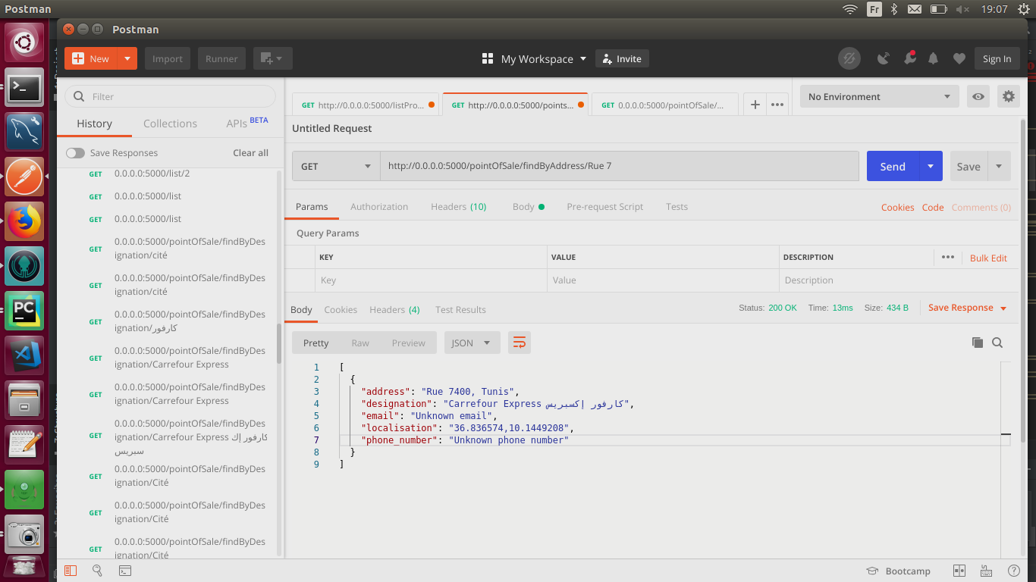
Implementation
Searching a point of sale just by enter a few letters
6

Slide 11
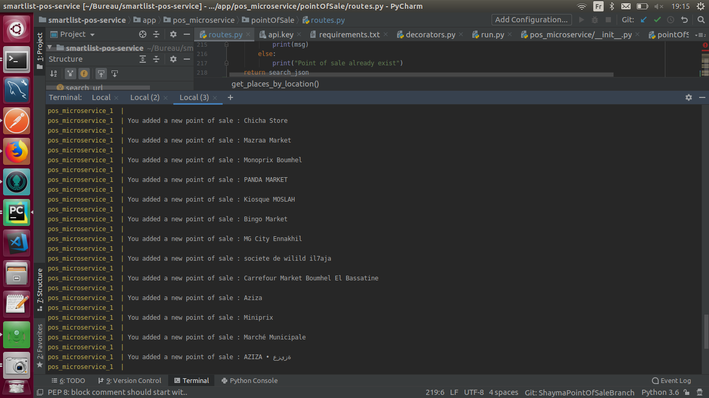
Implementation
Search a point of sale if it’s found by the api of google Map it will be automatically added to the database
6

Slide 12
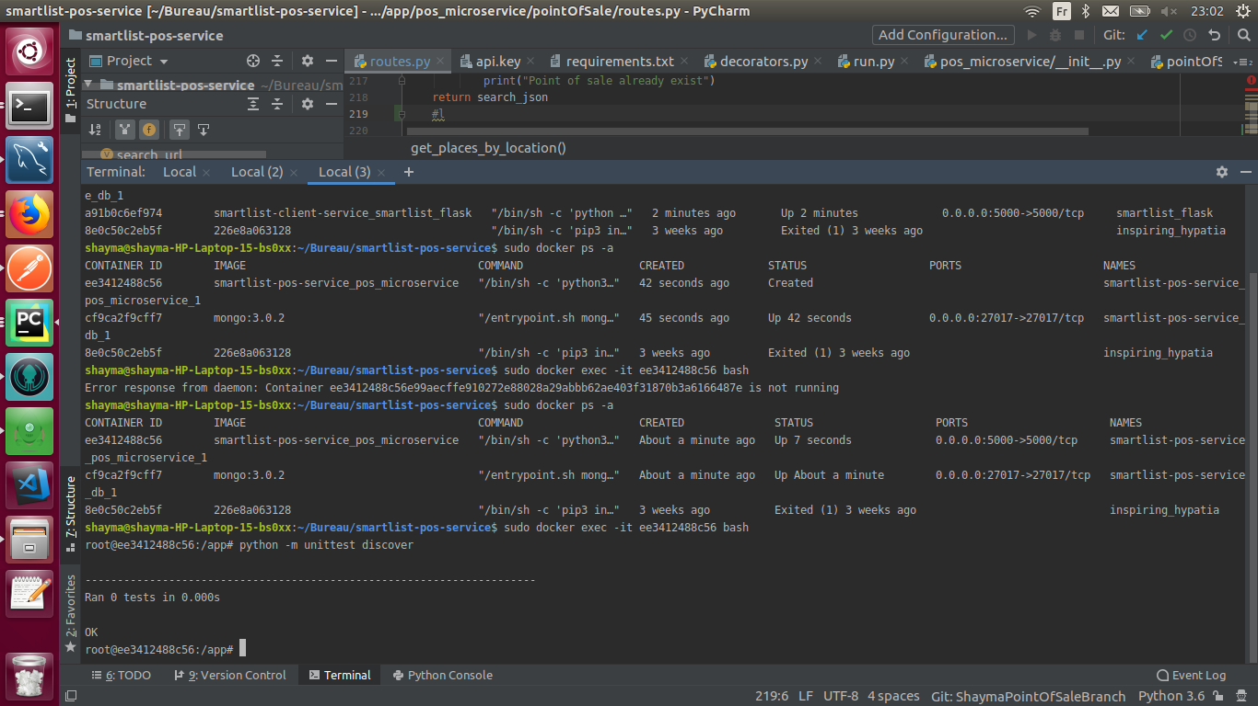
Implementation
Unittest of the point of sale microservice
6

Slide 13
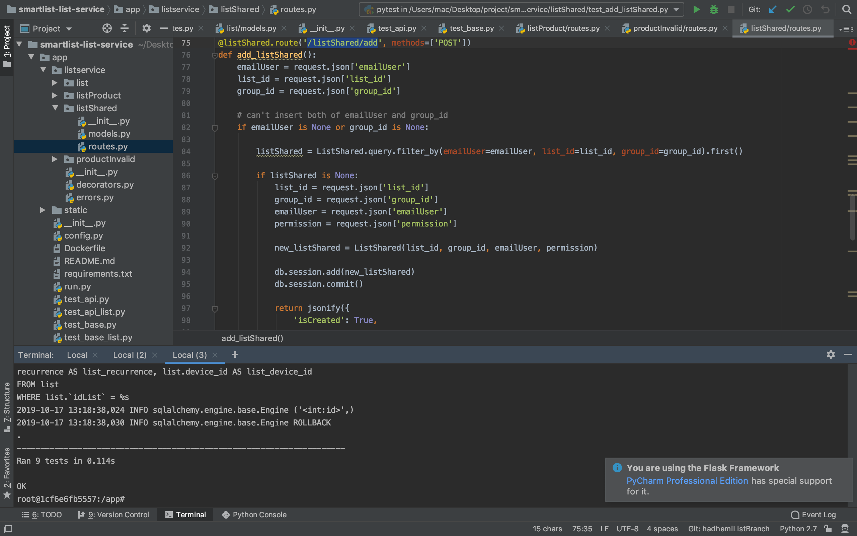
Test

Slide 14


